Slide 1
ARM Templates
Linked Templates

Slide 2
Brief Overview
This is part 2 of 2. First part being covering Nested Templates. ← Click here for link to that video.
This video basically covers the following link : https://learn.microsoft.com/en-us/azure/azure-resource-manager/templates/linked-templates?tabs=azure-cli
Its going to show you multi step approach to achieving linked templates with ARM and why/why not we do certain actions and the importance of what we do and don’t do.

Slide 3
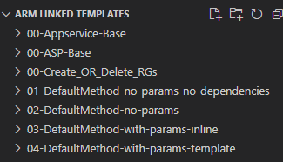
Quick Overview of Directory
00-xxxx folders denote base templates and steps, think of pre-requisites. For example 00-ASP-Base is just a simple ARM template that deploys App Service Plan.
01-xxxx folder is a basic approach to using linked templates without the use of parameter files or DependsOn clauses.
02-xxxx folder is basic approach with using DepondsOn clause which gets rid of chicken before egg issue.
03-xxxx folder is a better approach using inline parameters.
04-xxxx folder is a better approach using parameter files stored in storage account.

Slide 4
00–ASP / 00-Appservice / 00-Create RG
00-Create_OR-Delete_RGs = Simple AZ CLI commands to create the RGs reference in the “example” templates/parameters.
00-ASP-Base = Basic template to deploy ASP.
00-Appservice-Base = Basic template to deploy Appservice.

Slide 5
01-DefaultMethod-no-params-no-dependencies
appservice-template-example.json has all expected values stored inside “variables” portion of the template. No use of parameter files nor DependsOn clause.
This template simply pases the name of the ASP deployed in parent template + the URI of the solo deployable Appservice template in storage account.

Slide 6
02-DefaultMethod-no-paramsdependencies
Same exact settings as 01-DefaultMethod-no-params-no-dependencies except that the parent template has proper DependsOn clause to avoid chicken before the egg issue.

Slide 7
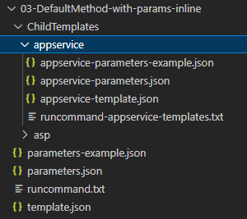
03-DefaultMethod-with-params-inline
appservice-template.json is prepped to use appservice-parameters-example.json or appservice-parameters.json (after you fill in values) to use.
Parent template has 2 examples of using inline parameters, 1st is “hard-coded” value and 2nd is passing in from the parent parameter file a value for consumption.

Slide 8
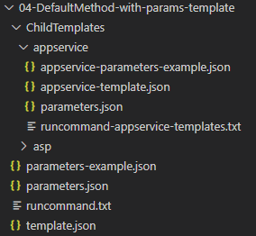
04-DefaultMethod-with-params-template
Similar to 03-DefaultMethod-with-params-inline except that the parent parameter file does not pass in any values for consumption nor are there any “hard-coded” values passed in. The parent template points to a parameter file located in a storage account that has all the parameter values for consumption.

